Slide 1
REGRESSION MODELS

Slide 2
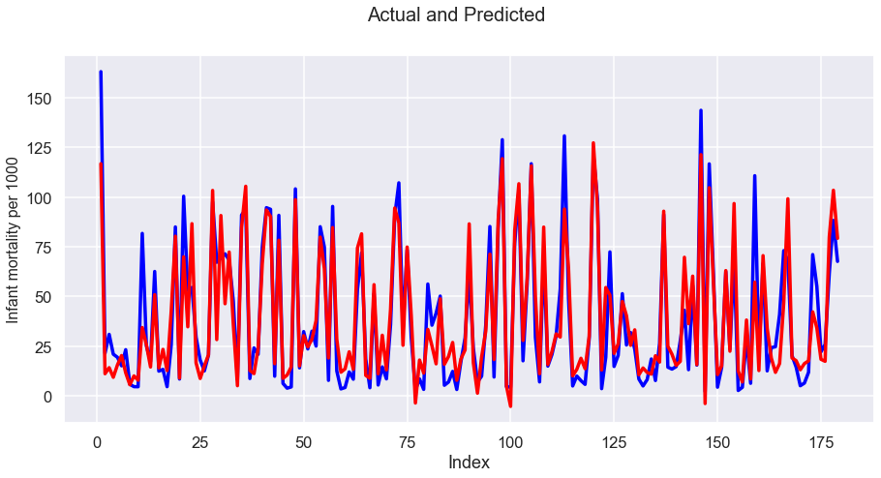
INFANT MORTALITY PER 1000.

Slide 3
Mean_Squared_Error : 196.54831472411684
r_square_value : 0.8418570917300704
We get this model by using Birthrate and Death Rate as predictors.

Slide 4
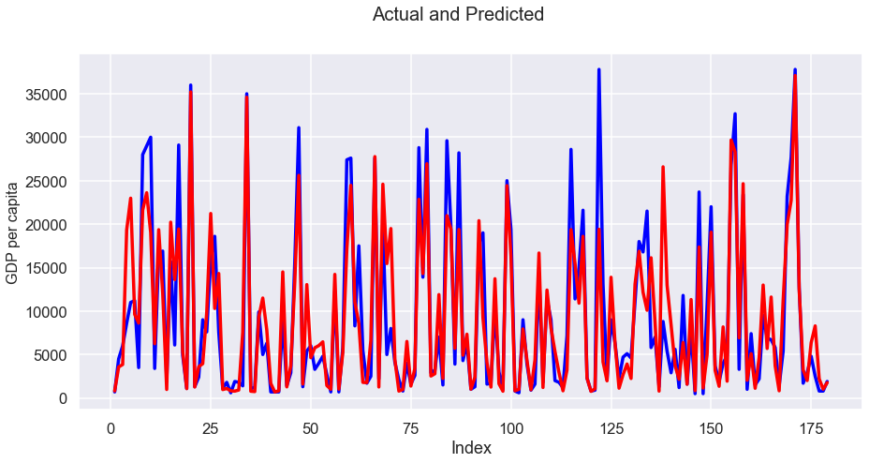
GDP PER CAPITA

Slide 5
Mean_Squared_Error : 20291478.61835974
r_square_value : 0.7806077766657586
Above prediction is done by using Phones per 1000 as a predictor.
Model has been obtained after constructing several other models.

Slide 6
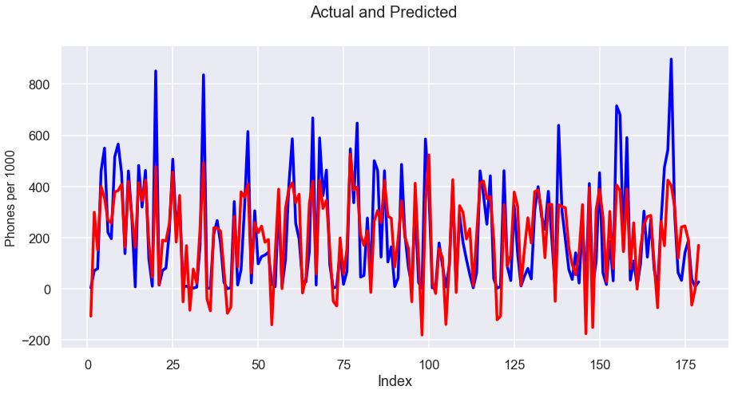
PHONES PER 1000

Slide 7
Mean_Squared_Error : 16352.051816635989
r_square_value : 0.6275544868232983
This is got by using Service and Birthrate as predictors
This model looked better taking ’ GDP per capita’ as a predictor. But cond.no was observably very high and hence had to drop that model.

